Slide 1
Term Paper Title
Your Name
Department of Computer Science & Engineering
Wright State University
Dayton, OH 45435

Slide 2
Outline
Scheduled Traffic Model
Problem
Iterative Survivable Routing
Performance Evaluation
Summary

Slide 3
General Survivable Routing and Wavelength Assignment Problem
Given a network topology, link state info, and a set of connection requests,
  find two link disjoint paths, one working path and one protection path, for each connection request, and
  the objective is to minimize the total network resources (e.g., number of wavelength-links) used by working paths and protection paths of all demands
  while 100% restorability is guaranteed against any single failure

Slide 4
Traffic Models
Static traffic
  All demands are known in advance and do not change over time
Dynamic random traffic
  A demand arrives at a random time, the inter-arrival time and holding time of demands are random or conform to some probability distribution
Incremental traffic
  Demands arrive sequentially
  Lightpaths are established for each demand and remain in the network indefinitely

Slide 5
Scheduled Traffic Model
Scheduled traffic demand r = (s, d, n,α,β)
  s: source node
  d: destination node
  n: number of requested lightpaths
  α: setup time
  β: teardown time
Characteristics of scheduled traffic model
  Short-lived and dynamic in the sense that demands only last during the specified time intervals (vs. static traffic model)
  setup times and teardown times of demands are known in advance (vs. dynamic traffic model)

Slide 6
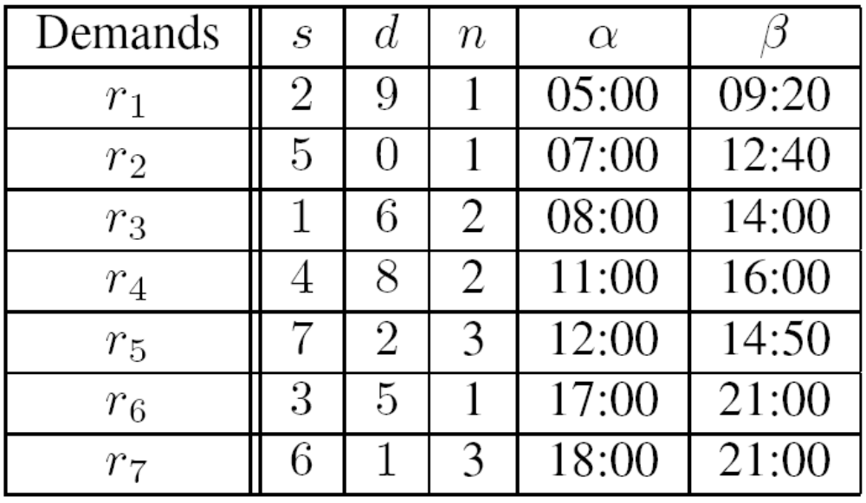
Scheduled Traffic Model
An example of a scheduled demand set

Slide 7
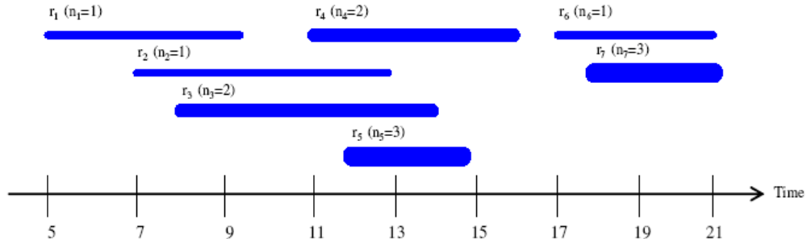
Scheduled Traffic Model
Time domain of the example demand set
Observation
  Time disjointness among demands
Motivation
  Network resource reuse in time

Slide 8
Problem
Solve the survivable service provisioning problem under the scheduled traffic model
  by processing demands sequentially
  using a capacity provision matrix based Iterative Survivable Routing (ISR) algorithm
  the algorithm runs iteratively to approximate the optimal solution

Slide 9
Iterative Survivable Routing
Capacity Provision Matrix based Optimization Model
  Link incidence matrix of working paths:
    Row vector represents the working path of demand r; its l-th element takes on 1 if the working path passes through link l.
  Link incidence matrix of protection paths:
    Row vector
  Capacity provision matrix:
    indicates the minimum total capacity required on link l when link k fails
  Capacity vector:
    The minimum total capacity required on each link
  Total number of wavelength-links used:
    e is a unit column vector of size L

Slide 10
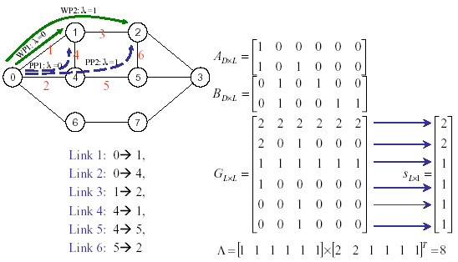
Iterative Survivable Routing
Example

Slide 11
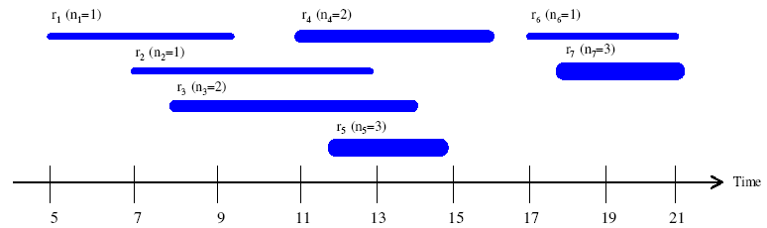
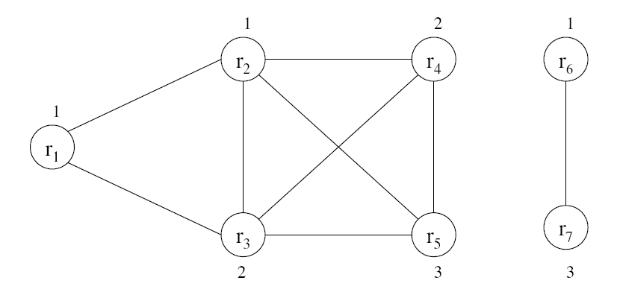
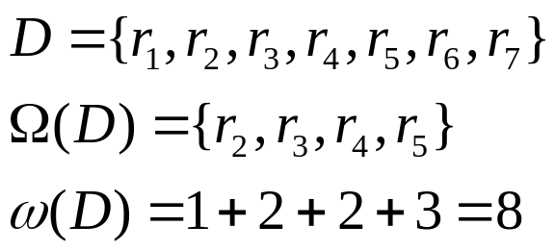
Iterative Survivable Routing
Determination of capacity provision matrix
  Maximum weight clique (MWC) problem
    Weighted interval graph
    Set of demands in MWC:
    Weight of MWC:

Slide 12
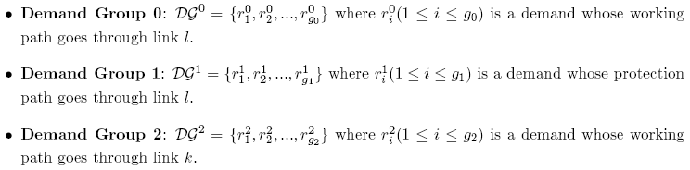
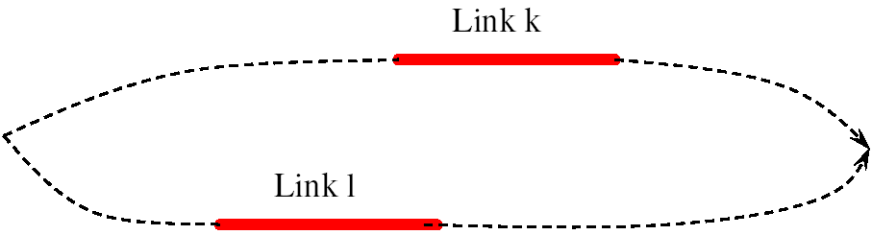
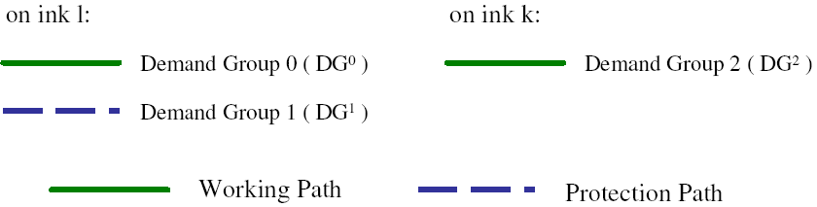
Iterative Survivable Routing
  Three demand groups

Slide 13

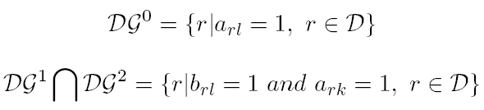

Iterative Survivable Routing
  Calculation of matrix G

Slide 14
Iterative Survivable Routing
Demand scheduling policies
  Earliest-setup demand first (ESDF)
  Earliest-teardown demand first (ETDF)
  Most conflicting demand first (MCDF)
  Least conflicting demand first (LCDF)

Slide 15
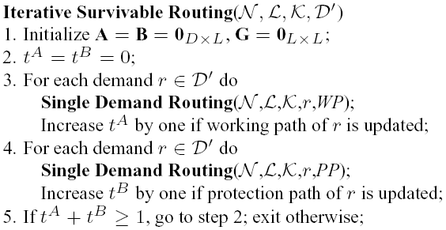
Iterative Survivable Routing
Iterative survivable routing (ISR)
  Basic steps of ISR

Slide 16
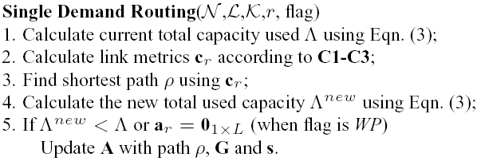






Iterative Survivable Routing
  Single demand Routing
      Calculate
      Calculate
      Link metrics:
      Calculate
      Calculate
Step 2
Step 4

Slide 17
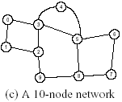

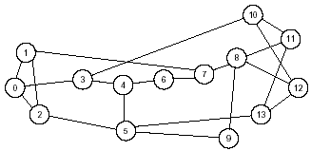
Performance Evaluation
Example networks
  Three small networks
  14-node and 42-link topology

Slide 18
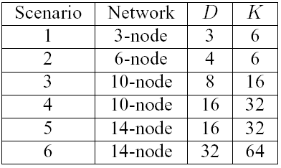
Performance Evaluation
Scenario information

Slide 19
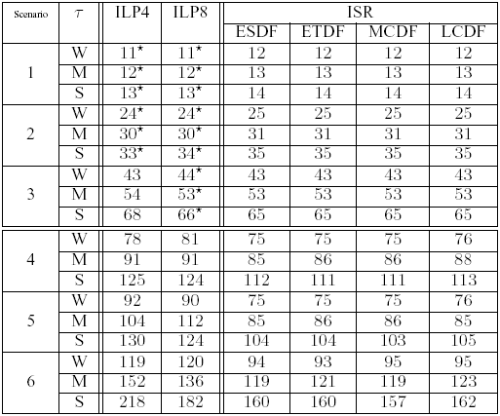
Performance Evaluation
Iterative Survivable Routing Algorithm versus ILPs
  Total number of wavelength-links used

Slide 20
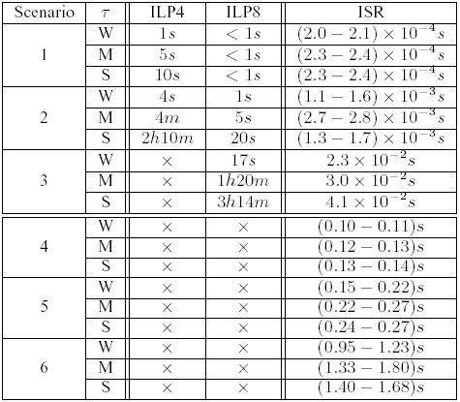
Performance Evaluation
Iterative Survivable Routing Algorithm versus ILPs (cont.)
  Computational time

Slide 21
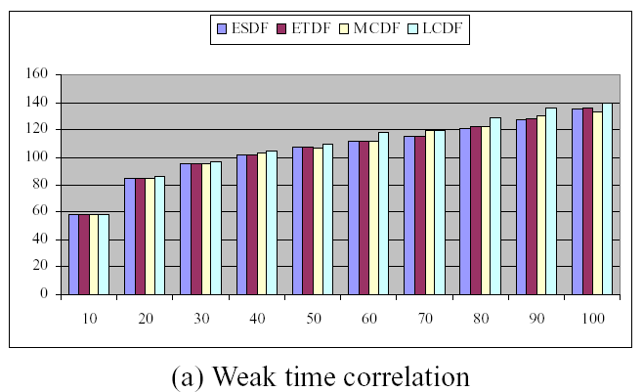
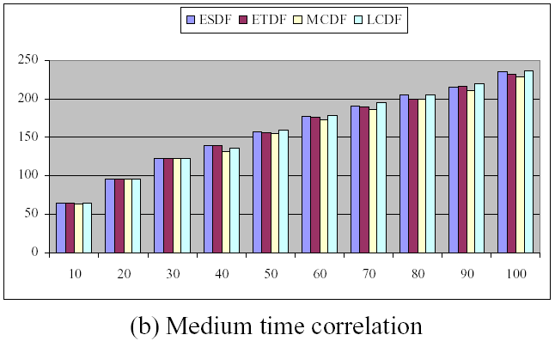
Performance Evaluation
Impact of Scheduling Policies on Iterative Survivable Routing Algorithm in Larger Networks

Slide 22
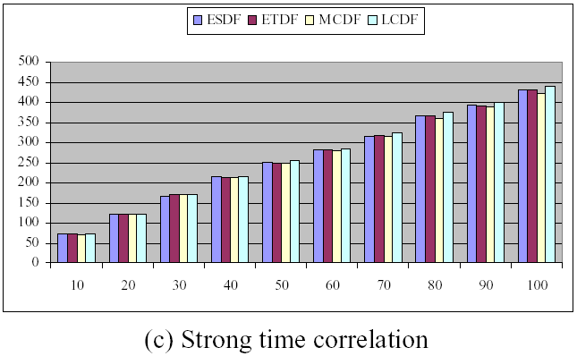
Performance Evaluation
Impact of Scheduling Policies on Iterative Survivable Routing Algorithm in Larger Networks (cont.)

Slide 23
Summary
Optimal survivability design under a scheduled traffic model in wavelength convertible WDM mesh networks
Objective - minimize the total number of wavelength-links to accommodate a set of traffic demands
Exploit network resource reuse in both space and time
Iterative survivable routing algorithm can achieve good solutions in much less time compared with ILPs, especially when the problem size is large

Slide 24
Questions?
Thanks!

